Slide 2
How to Become a Microsoft Learn Student Ambassador
MM. Salman Faris

Slide 3
Learning Objectives
What is MLSA?
Benefits of being an MLSA
Application process
What to do once you become an MLSA?
Stages of MLSA and its benefits

Slide 4
What is MLSA?
The Student Ambassadors program provides plenty of opportunities for you to learn and lead so you can make a difference and empower those around you.
You might find yourself helping fellow students build their coding skills online with Microsoft Learn, organizing a virtual hackathon to solve real-world challenges, earning certifications, or building digital communities it’s all up to you.
Notes:
Please adjust this slide to the end of your presentation
https://go.microsoft.com/fwlink/?linkid=2271366

Slide 5




Slide 6
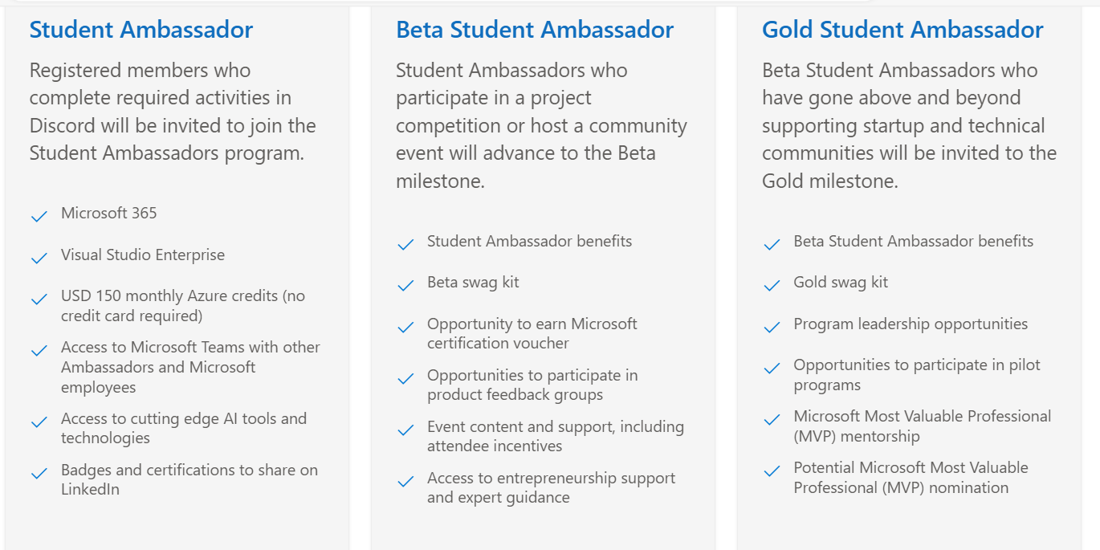
Benefits of being a MLSA

Slide 7
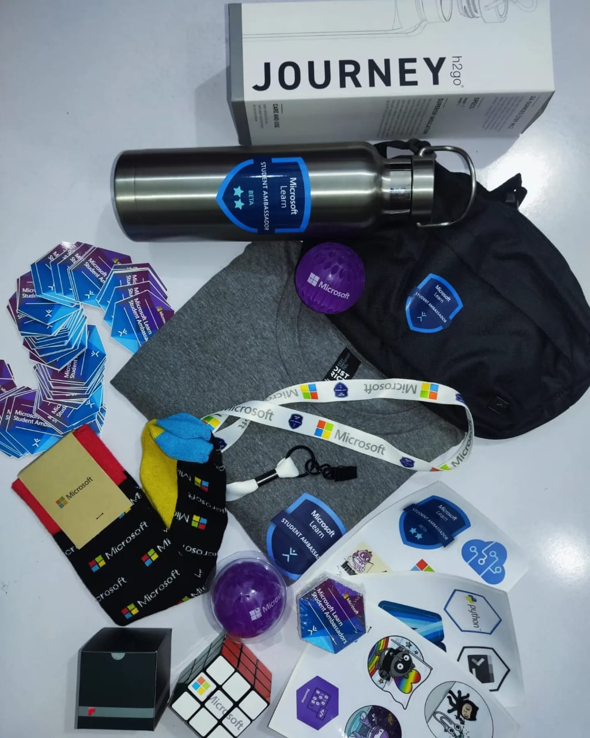
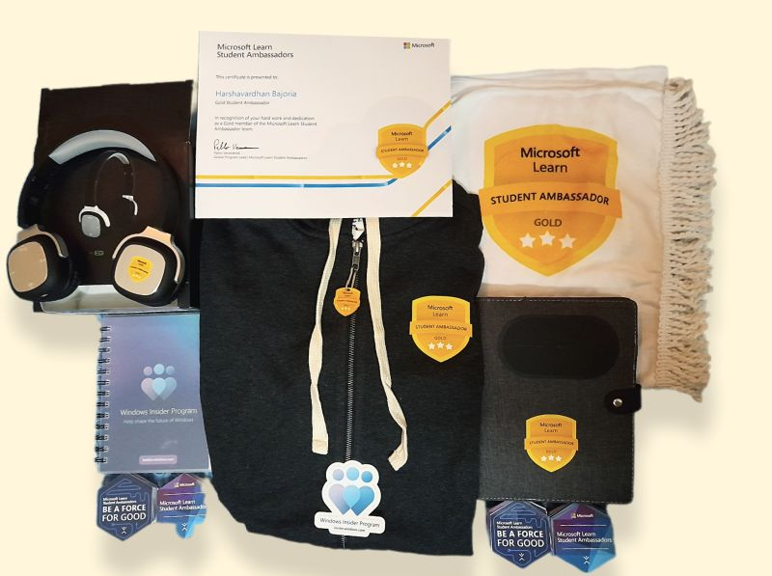

Slide 8
Application Process

Slide 9
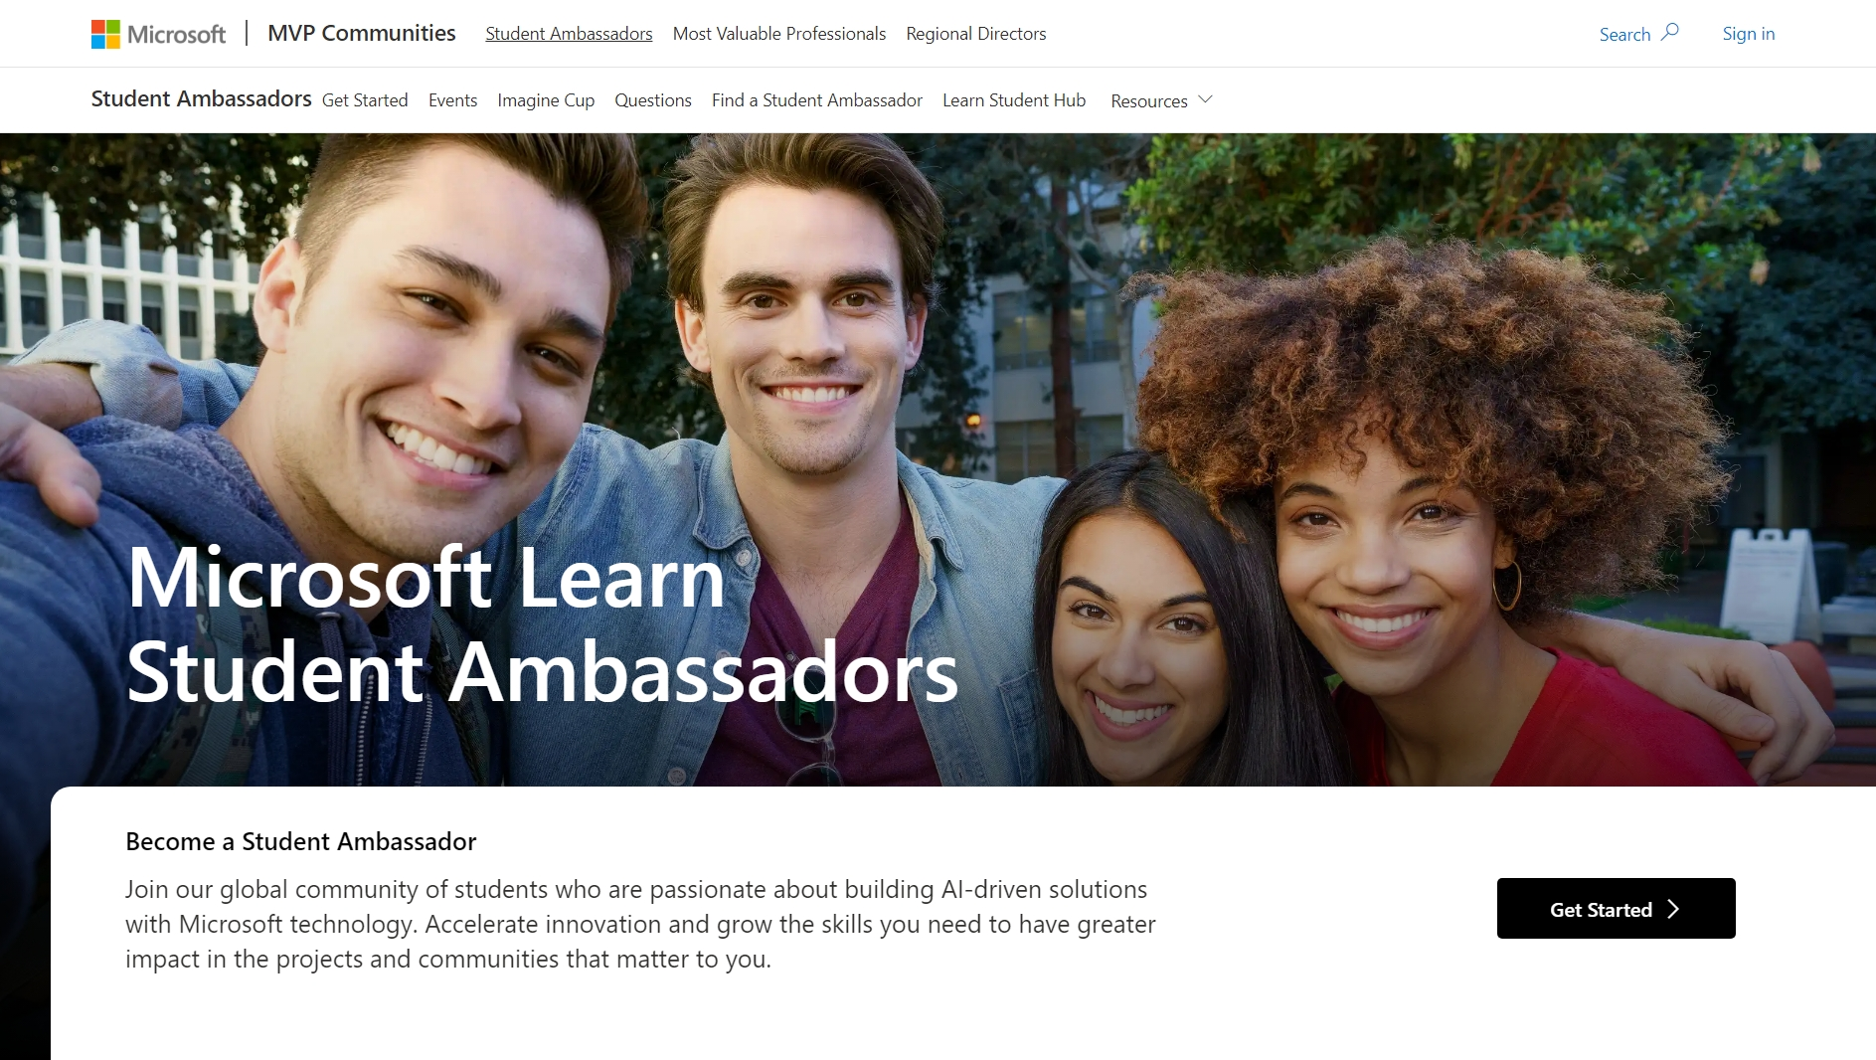

Slide 10
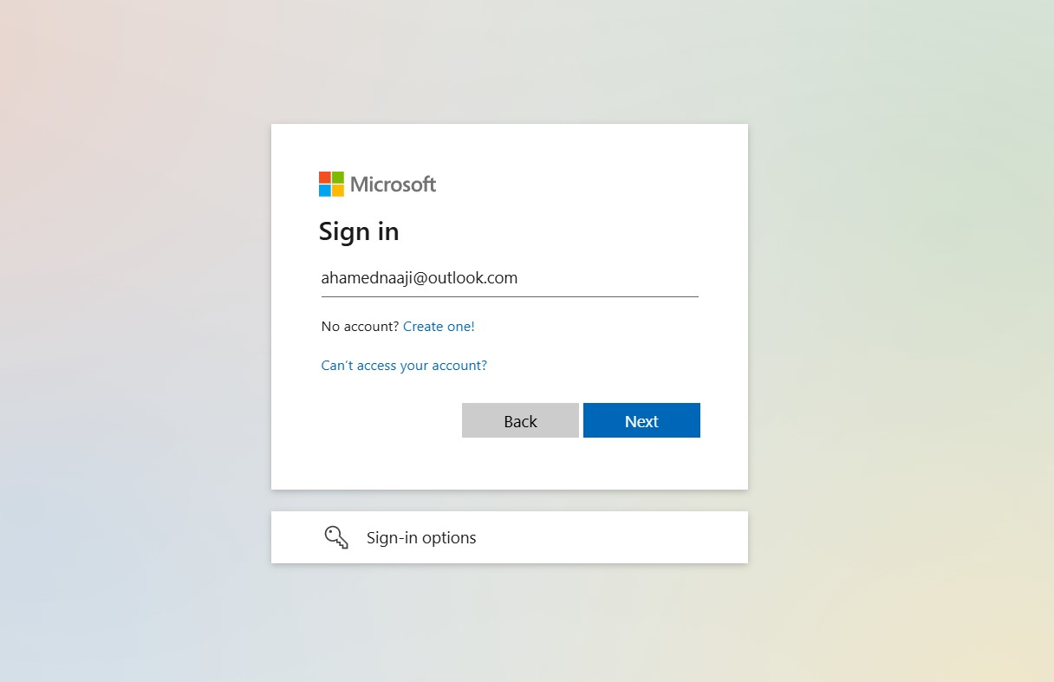

Slide 11
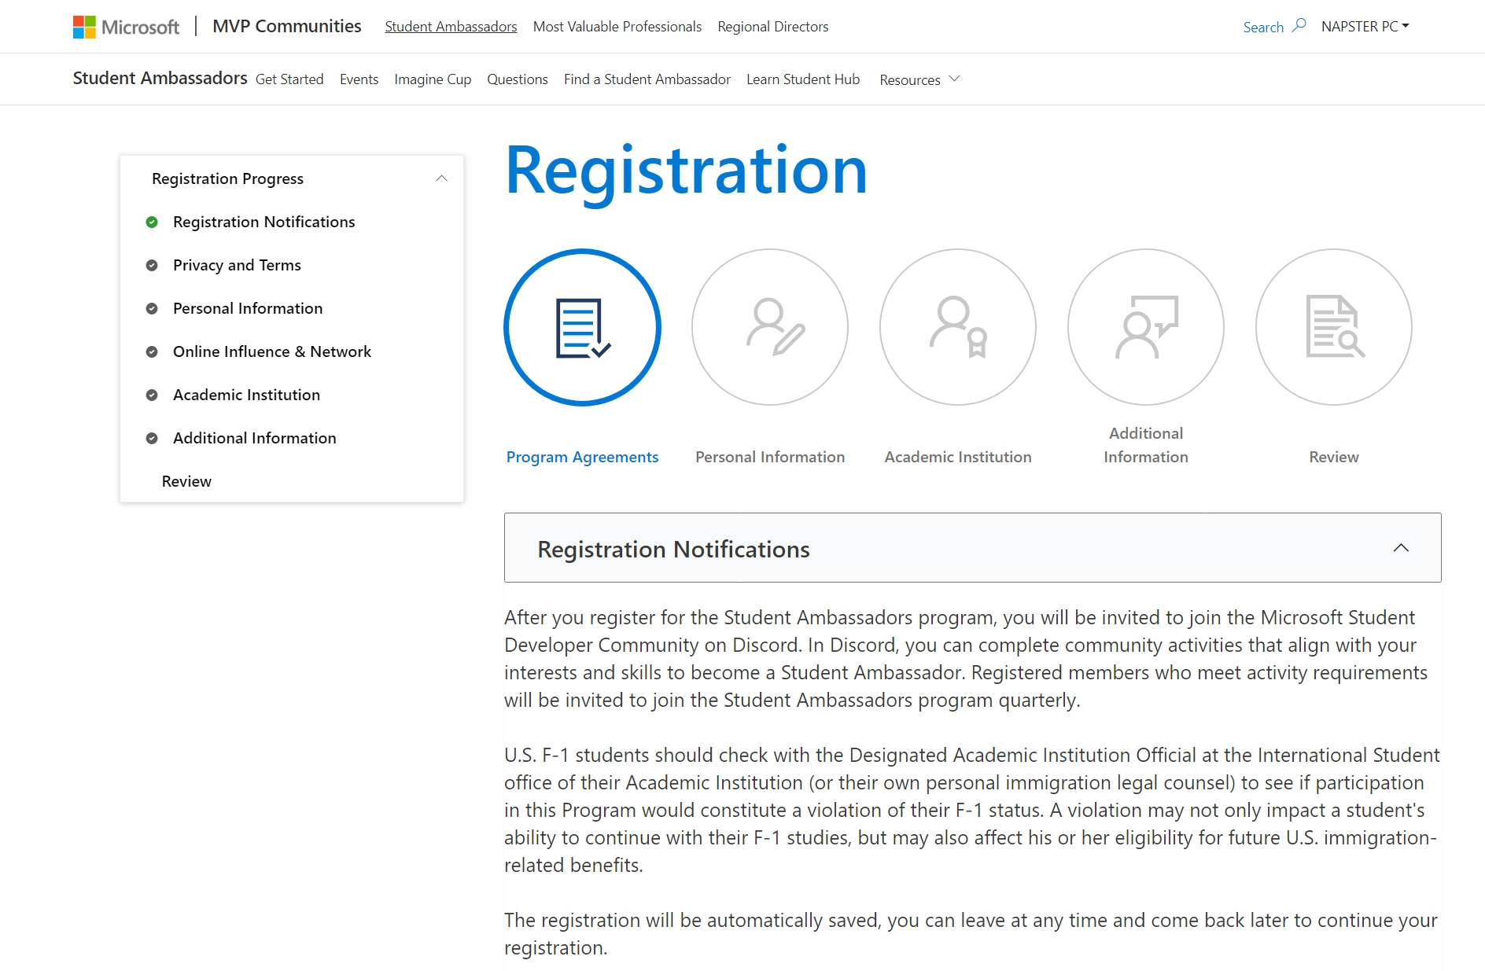

Slide 12
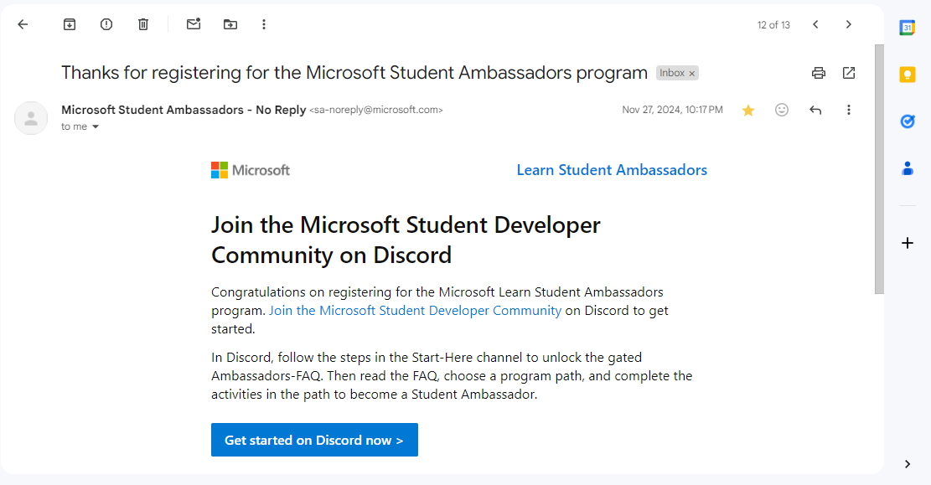
What happens after registration?

Slide 13
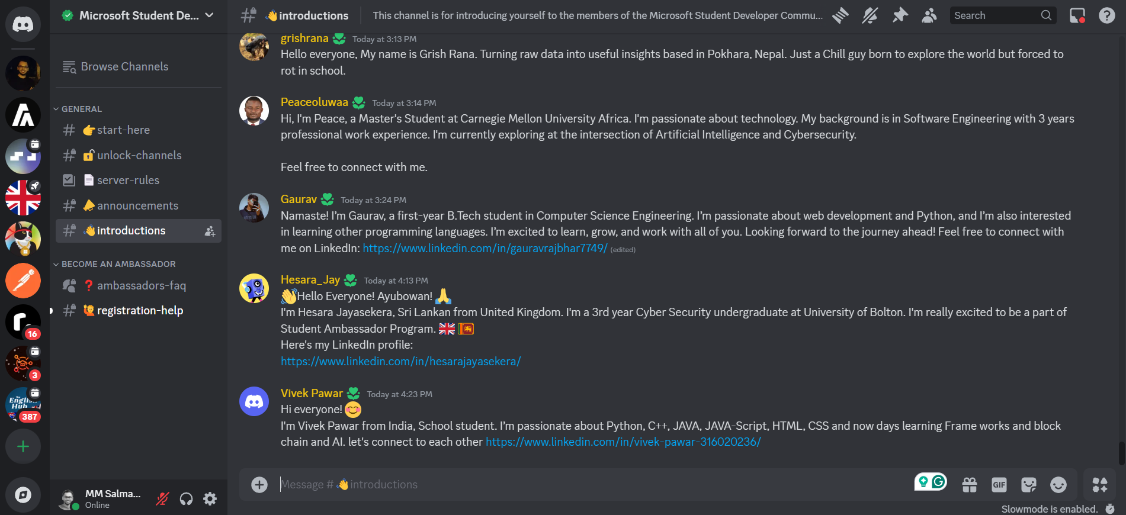
Discord Channel for MLSA

Slide 14
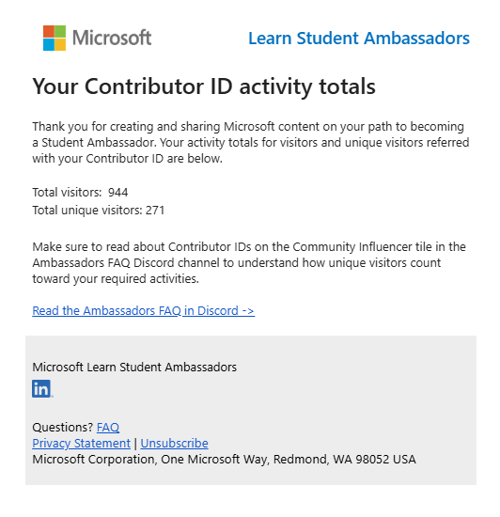
Contributor ID

Slide 15
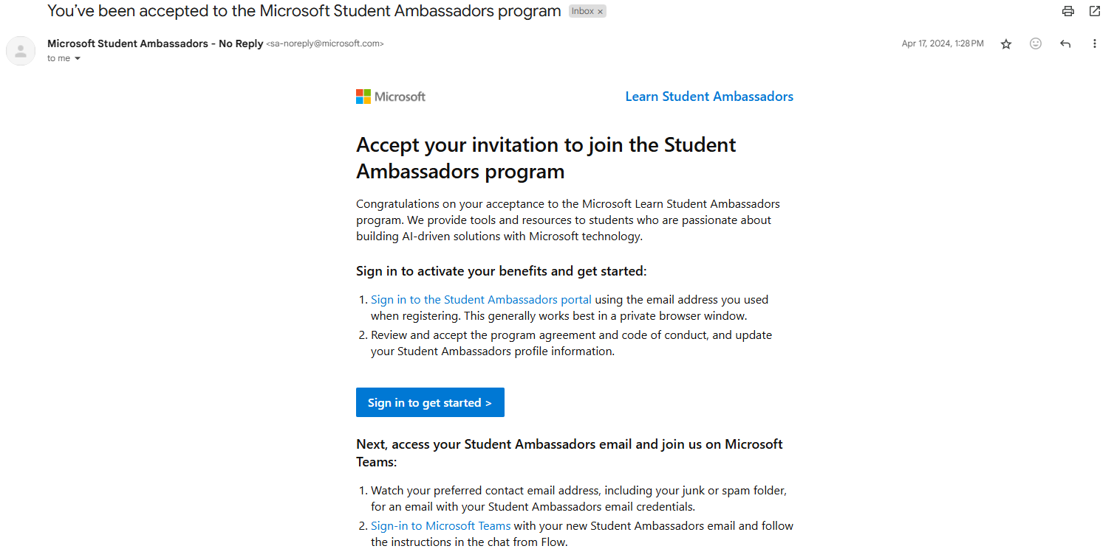

Slide 16
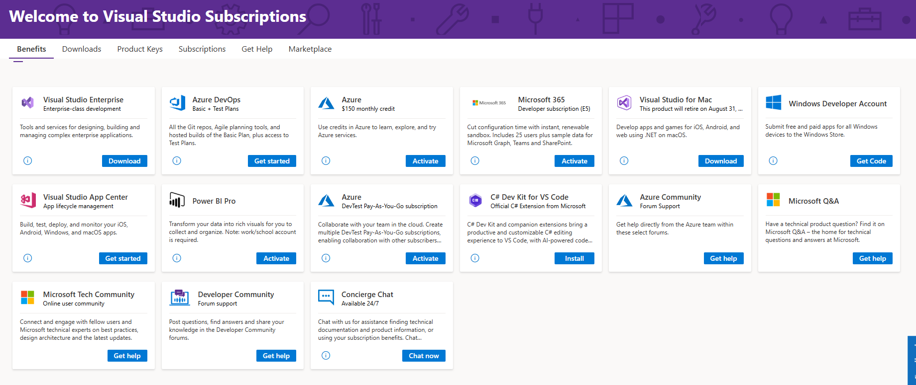

Slide 17
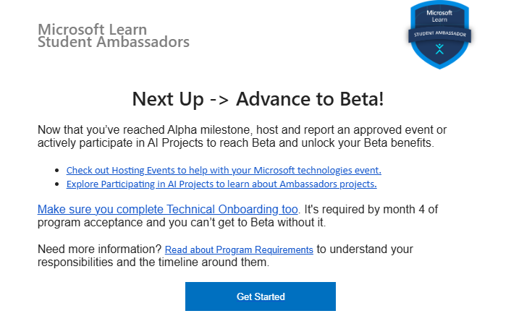

Slide 18
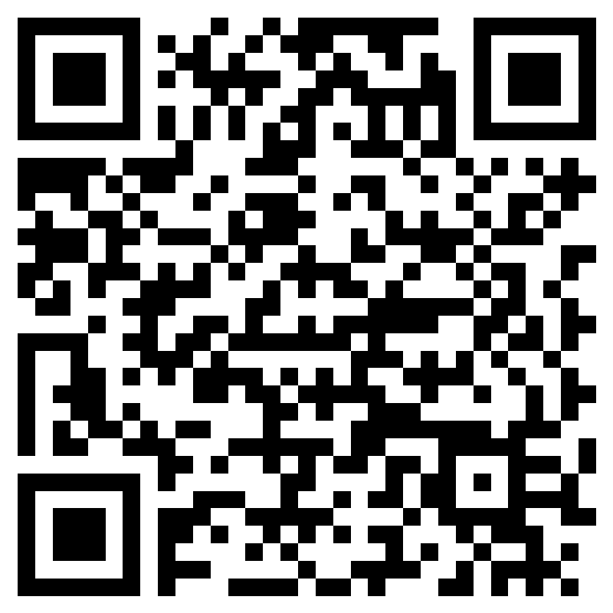
Event feedback form

Slide 19
Thank You

